Slide 1

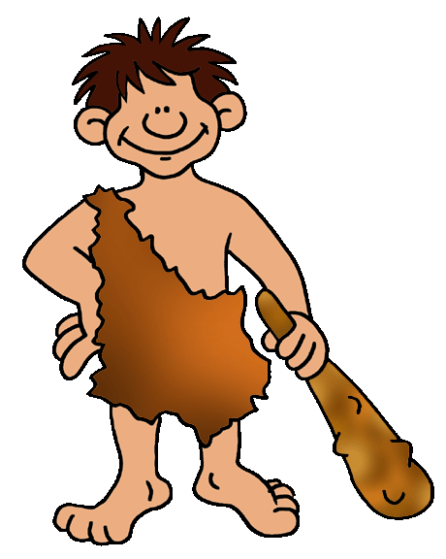
The First Humans
Hominids are the family of mankind
and his or her relatives.
Written by Lin Donn
Illustrated by Phillip Martin

Slide 2

65 Million Years Ago
Dinosaurs died out about 65 million years ago. The first human like hominids did not appear until around 3 million years ago.
Thus, no matter what you may have seen in the movies, early man did not live during the same period in history as dinosaurs!

Slide 3

3 Million Years Ago
3 million years ago, our planet was teeming with life!
There were deer, giraffes, hyenas, sheep, goats, horses, elephants, camels, beavers, cave lions, ants, termites, woolly mammoths, saber-toothed tigers, giant sharks, dogs with huge teeth, and all kinds of birds and plants and fish.

Slide 4
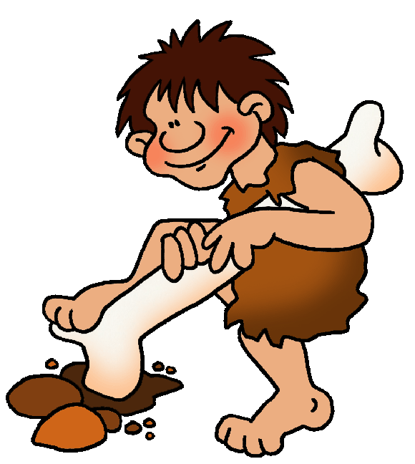
Very Early Humans
It was during this time that the higher primates, including apes and early man, first appeared.
There was a difference between apes and man. Early human-like hominids could stand upright. Apes could not.
Their hands were different, too. Ape hands were made for climbing and clinging. Man’s hands were jointed differently, which allowed them to make and use tools.

Slide 5
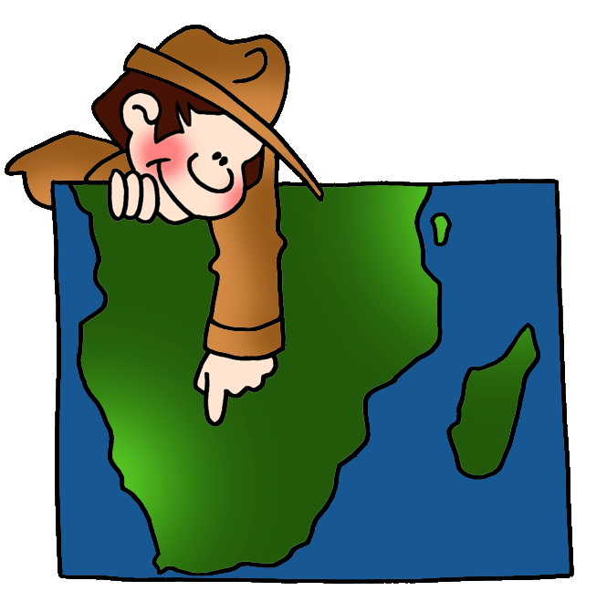
Very Early Humans
How do scientists know about an early man who lived 3 million years ago?
Lucy told them!

Slide 6
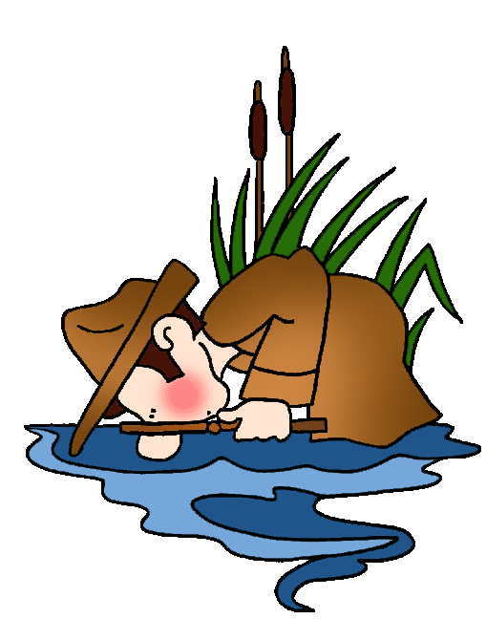
Lucy
In 1974, a skeleton was found in Africa. The bones were those of a female, about 20 years old or so when she died. Scientists named her Lucy. About 3 million years
ago, when Lucy was alive, she was about 4 feet tall and weighed about 50 pounds. Scientists suspect that she fell into a lake or river and drowned.
Scientists are like detectives. They can tell a great deal from a skeleton, whether it's one year old or 3 million years old!

Slide 7
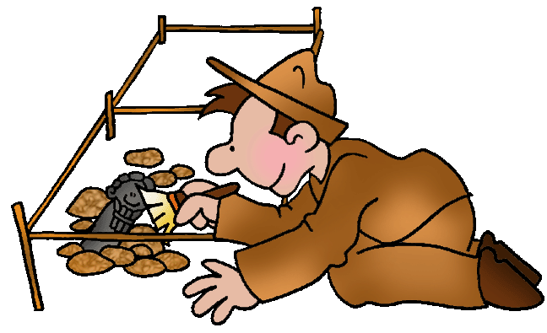
Fossils & Artifacts
Scientists use many clues to help them put pieces of the past together. One thing they must know is the difference between a fossil and an artifact.
Fossils are remains of living things (plants, animals, people), not things that were made.
Artifacts are remains of things that were made, not remains of living things.

Slide 8

Handy Man
The Stone Age refers to the materials used to make man-made tools. In the Stone Age, man made tools out of stone. “Handy Man” was one of the first hominids to use stone tools.
Hunters & Gatherers: The Old Stone Age people were hunters/gatherers. We know this because scientists have found fossils and artifacts, which reveal traces of their life. These people did not plant crops. They gathered wild fruits, nuts, berries, and vegetables.

Slide 9
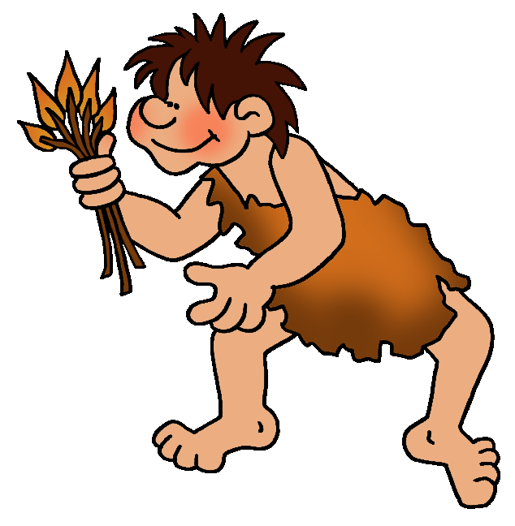
Handy Man
These early human-like hominids were taller and smarter than Lucy’s people, but they did not know how to make fire.
When they broke camp, they probably tried to bring fire with them by carrying lit branches to use to start a new campfire.
If their branches went out, they did without fire until they found something burning.

Slide 10
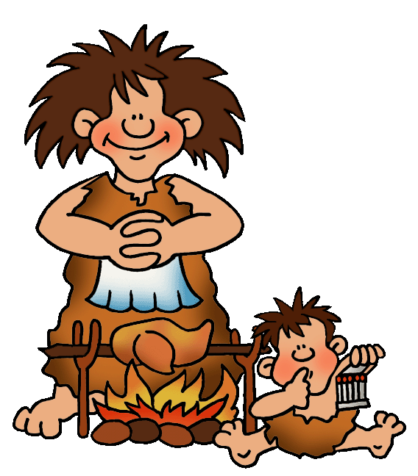
Upright Man
Many years passed. Another group of man was born. Scientists nicknamed this group “Upright Man”. Upright Man did know how to make fire.
That changed everything!
People began to cook their food, which helped to reduce disease. People collected around the fire each night, to share stories of the day's hunt and activities, which helped to develop a spirit of community.

Slide 11
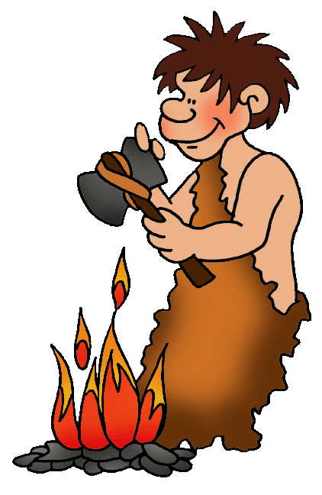
Upright Man
These Stone Age people were about the same size as modern humans. Their tool-making skills were considerably improved. Their weapons included stone axes and knives.
Because Upright Man could make fire, he was free to move about in search of food. He did not have to worry about freezing. He made warm clothes from animal skins. At night, he built a campfire to cook his food and to stay warm.

Slide 12

Man Leaves Home
About one million years ago, Upright Man began to slowly leave Africa. These early people began to populate the world.
They did not need a boat. The Ice Age was here! They traveled across giant walkways of frozen ice, over what later would become vast rivers and seas.
Scientists have found artifacts of their tools and weapons, which help us to understand how they lived, where they went, and how they got there.

Slide 13
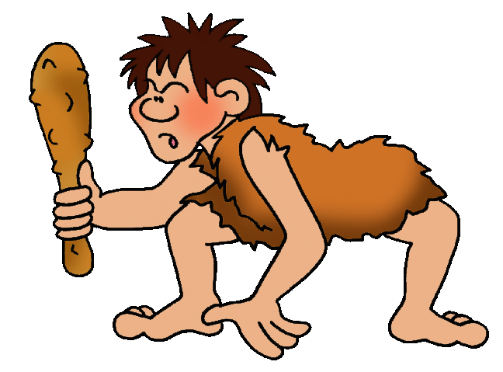
Neanderthals
One day, scientists found a new skeleton. This skeleton was from another group of early men. Scientists named this man Neanderthal man, after the valley in which the skeleton had been found.
Scientists announced that these early men were dim-witted brutes, who walked with bent knees, with their heads slung forward on their big necks. Could these early people really be our ancestors?

Slide 14
Neanderthals
But scientists had made a mistake!
The bones were bent because they were part of the skeleton of an old man suffering from arthritis! Arthritis is a disease that bends and cripples bones.

Slide 15
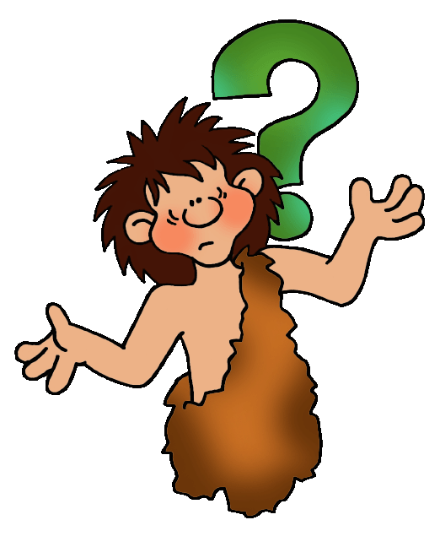
Neanderthals
Still, Neanderthals were different from other species of early humans. They were tall and smart, and used caves as their homes. They were great hunters.
Considering how smart they were, and how advanced for their time, scientists are puzzled that the Neanderthals were one of the early species of man to die out. Many species of man died out in these early days. But why the Neanderthals? It is a history mystery.

Slide 16
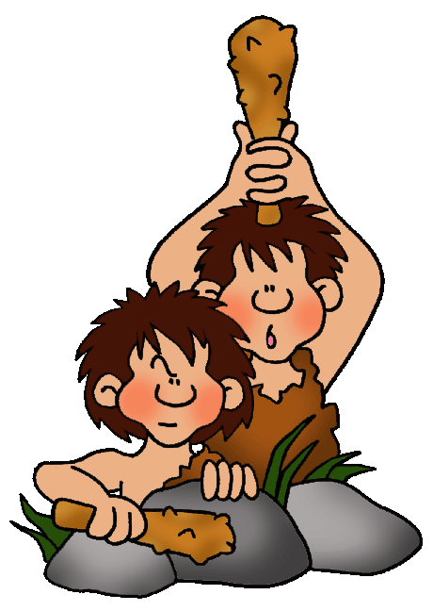
Cro-Magnon Man
Another group of early men stood out during this period. Scientists nicknamed this group “Cro-Magnon man”.
Cro-Magnon man lived in Europe.
This group did not live a life of constant struggle for survival because they worked together to provide food for their tribe.

Slide 17
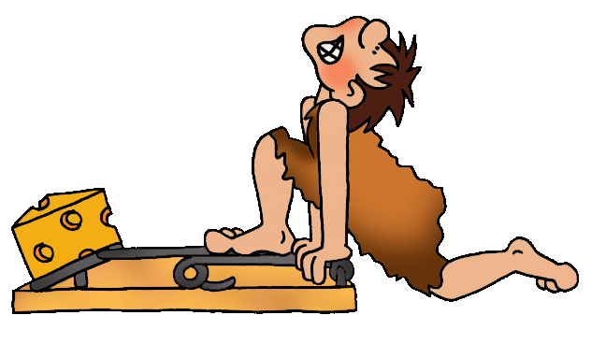
Cro-Magnon Man
These Stone Age people learned to cure and store food for the long winter. They used traps, which allowed them to catch food while they were busy doing something else. Fisherman used nets woven from vines and fishhooks.
Some groups built rafts and canoes to catch bigger fish in deeper waters.
They made clothing and jewelry. They invented the bow and arrow.

Slide 18
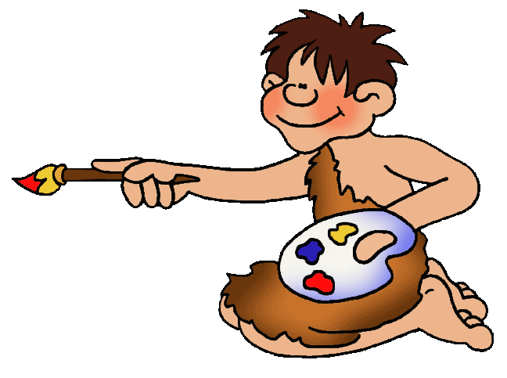
Cave Paintings
Cro-Magnon man did something rather unusual. For some reason, he drew paintings deep inside dark caves, on cave walls.
His paintings were added to the paintings already on the cave walls, left by other Cro-Magnon men.
Over time, a cave
might accumulate hundreds of paintings. Colors used most often were brown, yellow/tan, dark red, and coal black.

Slide 19

Cave Paintings
Animals were well drawn and filled in with natural colors to give them even more shape and substance. They drew stick figures for hunters. They drew stencils of hands.

Slide 20
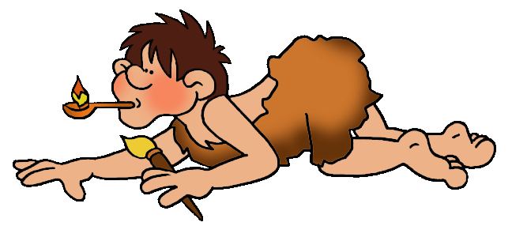
Cave Paintings
To reach the deepest part of the cave, where other paintings could be found, Cro-Magnon man had to crawl through the maze like tunnels of the cave, holding a spoon-like oil lamp to light his way, while carrying his carefully prepared paints.
Notes:
Teacher Notes: To avoid being burned, and to avoid having the lamp go out, it had to balanced carefully to hold the burning oil inside the rounded part of the spoon-like oil lamp.

Slide 21
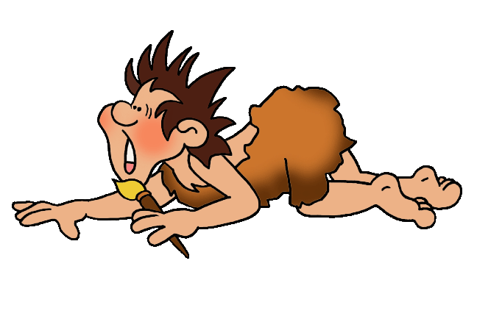

A Mystery
It was quite dangerous. Cro-Magnon man had no idea if he might run into a cave lion. He might fall into a hole and die.
Why did he do it? Perhaps it was a coming of age ceremony, or perhaps it served a religious purpose. Maybe it was a sort of, “I was here.”
There are many history mysteries. This is one of them.

Slide 22
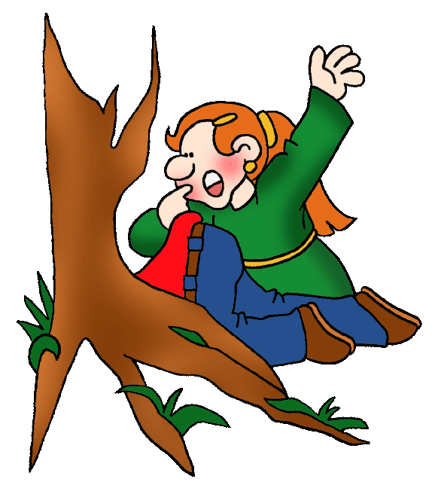
Lascaux France
The existence of cave paintings was discovered by accident. Around 1940, during World War II, some kids
were playing in a field in Lascaux, France. They stumbled across a cave entrance. It had been hidden by the tree roots. The walls were covered with cave paintings!
Once people knew the paintings existed, they looked for more such caves, and found them.
Notes:
Teacher Notes: Caves with paintings in them have been found in many parts of the world. There are probably more caves to be discovered.

Slide 23

Recap
We know about early Stone Age people because scientists have found fossils and artifacts that reveal traces of their life.
Man went through many stages to evolve into the humans of today! Since this evolution covers roughly 3 million years, you might say it took man a long time to grow up!

Slide 24

Early Humans
Questions
What is a hunter-gatherer?
What is a Stone Age?
Why was the ability to make fire so important?
How could early humans travel from Africa to Australia without a boat?
What did Cro-Magnon man paint on cave walls?
Why did Cro-Magnon man paint on cave walls?
Notes:
Answers:
Someone who gathers food growing wild, and hunts for food.
A time in history when tools were made from stone
Fire helped people survive. Fire was a source of heat, to stay warm in the Ice Age. Fire let them cook their food, which reduced the incident of disease. The ability to make fire allowed them to live and move about freely, in search of food and shelter, knowing they could relight a fire when needed.
It was the Ice Age. They walked.
Stick figures of people, well drawn animals, and stencil drawings of human hand prints
No one knows. It’s a history mystery. Archaeologists have put many pieces of the past together. But there are many pieces yet to be discovered.

Slide 25
Learn More
For the answers to these questions,
click on these links.
LEARN MORE about Early Man_x000b_and play some free games
DRESS UP YOUR HOMEWORK
with art created by a professional artist

Slide 26
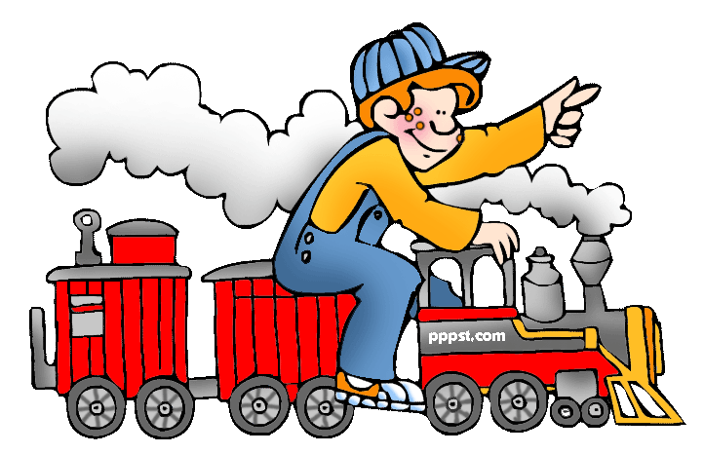
Click on the link below to explore …
PPPST.COM

